Slide 1
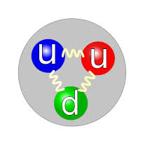
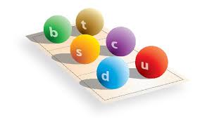
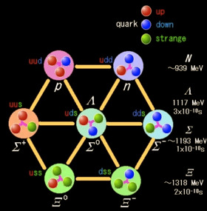
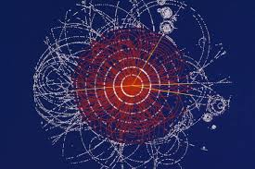
Quantum Chromodynamics
Colin Smith

Slide 2

What is it?
Quantum chromodynamics is a theory of quantum mechanics describing the forces between quarks
It describes the color charge, the charge of the strong nuclear force

Slide 3
Quarks
There are two sets of quarks, each set has three generations
The up set has up, charm, and top quarks which each have +2/3 charge
The down set has down, strange, and bottom which each have -1/3 charge

Slide 4
Quark particle chart
name | symbol | charge | spin | Mass (Mev/c²)
Up | u | +2/3 | ½ | 2.3
Down | d | -1/3 | ½ | 4.8
Charm | c | +2/3 | ½ | 1,290
Strange | s | -1/3 | ½ | 95
Top | t | +2/3 | ½ | 173,340
bottom | b | -1/3 | ½ | 4,650

Slide 5
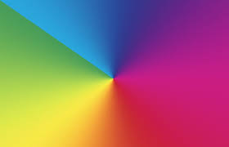
Color charge
This is really confusing
Red, blue, green, anti-red, anti-blue, and anti-green
Particles have to be neutral colored so they have to be a color / anti-color pair or RGB or anti-RGB

Slide 6
Glouns
These massless particles transmit the strong force between quarks
They are not color neutral, they have a color and an anti-color but not two corresponding ones

Slide 7
Gluons cont.
When a quark changes color it emits a gluon which has the old color of the quark as well as the anti-color of the quarks new color
When a gluon hits a quark, it will cancel the quarks color with whatever anti-color it has and replace the quarks color with its (the gluon’s) color

Slide 8
Quantum fluctuation
Empty space is not empty… its quantum mechanics what did you expect…
The vacuum is full of virtual particles popping in and out of existence however between two quarks the fluctuation is reduced between the quarks which created an energy gap
gluons are conducted through this energy gap and create a sort of tube

Slide 9
The strong force
With the gap in the quantum fluctuations transmitting gluons and the color charge attracting quarks you might think you have a full picture of the strong force… Wrong
The strange twist on this force is that once an energy gap is created and it conducts gluons, trying to separate the quarks takes so much energy because you expand the energy gap and create a quark anti-quark pair, this results in 2 gluon tubes which if you try to separate will o the same

Slide 10
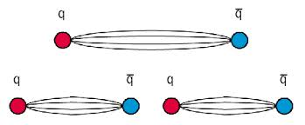
Strong force cont.

Slide 11
Mesons
there are two types of quark based particles
Mesons are the first, made of one quark and one anti-quark, they almost always decay into pions however the extremely heavy ones (such as a charm anti-bottom meson) might decay into baryons
These particles have one colored quark and one anti-colored quark

Slide 12
baryons
Baryons are the more familiar particles, they are made of three quarks and all eventually decay into the proton
Gluons interact between the three quark or anti-quarks constantly changing the color arrangements and transmitting the attraction between the quarks

Slide 13
Strong decay
Mesons and baryons decay as I mentioned but how does this actually happen?
Some mesons and baryons decay through the weak force in which the particle decays into leptons and neutrinos but the more relevant decay mode is through the strong force
In this decay a quark will decay into another quark

Slide 14
Strong decay cont.
When a quark decays into another quark it will either change into the same type (up type to up type / down type to down type) and emit a photon or it will change (up to down or vice versa) and emit a lepton with the proper charge
If an up quark decays into a down quark then a positron (or other anti-lepton) must be emitted in order to balance the charge
+2/3(up)=-1/3(down)+1(anti-lepton)

Slide 15
Hypothetical stuff
Tetra-quarks- these particles are theorized to have 4 quarks (2 quarks, 2 anti-quarks) they would be extremely unstable and difficult to produce
Glueballs- these are clusters of gluons which are color neutral an are therefore able to move freely through space, they would move at the speed of light, none have been detected

Slide 16
More hypothetical stuff
QGP- Quark-gluon plasma, theorized to take place at extreme temperature, the quarks are moving to fast to cause energy gaps and therefore escape the strong force, a soup of free quarks and gluons would exist
Strange matter- this mysterious form of matter is a low energy soup of up, down, and strange quarks, not much is known about it but it is a base form of matter and anything it touches will be reduced to strange matter

Slide 17
The last slide of hypothetical stuff
Squarks and gluinos- in string theory there is a special property called super symmetry, it involves every particle having a “partner”. Each quark has a partner “squark” and gluons have partners “gluinos”

Slide 18


Slide 19
Fin

